Slide 1

AtliQ Hardwares
Ad Hoc business insights requests
By: João Pedro

Slide 2
Purpose
The purpose of this presentation is to show stakeholders from AtliQ Hardwares store insights from the company’s data through ad hoc analysis of their database
This will increase knowlegde to facilitate data driven business decisions
All data is available from the project folder, including database sql file and sql queries

Slide 3
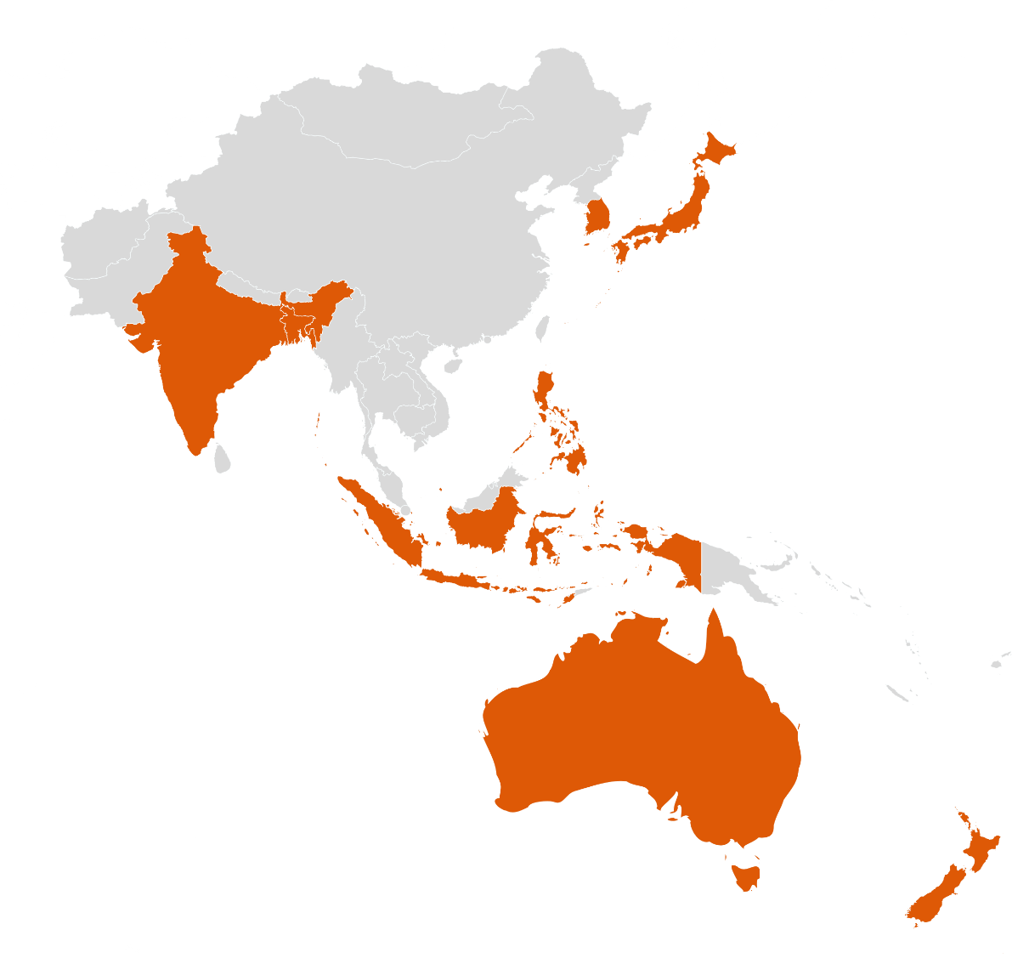
markets in which customer Atliq Exclusive operates it’s business in the APAC region.
market
Australia
Bangladesh
India
Indonesia
Japan
Newzealand
Philiphines
South Korea

Slide 4
What is the percentage of unique product increase in 2021 vs. 2020?
unique_products_2020 | unique_products_2021 | percentage_chg
245 | 334 | +36%

Slide 5
report with all the unique product counts for each segment and sort them in descending order of product counts
Number of unique products for each segment
segment | product_count
Notebook | 129
Accessories | 116
Peripherals | 84
Desktop | 32
Storage | 27
Networking | 9

Slide 6
Which segment had the most increase in unique products in 2021 vs 2020?
segment | product_count_2020 | product_count_2021 | difference
Desktop | 7 | 22 | 313%
Networking | 6 | 9 | 149%
Accessories | 69 | 103 | 148%
Storage | 12 | 17 | 141%
Peripherals | 59 | 75 | 126%
Notebook | 92 | 108 | 116%

Slide 7


Products that have the highest and lowest manufacturing costs
product_code | product | manufacturing_cost
A6120110206 | AQ HOME Allin1 Gen 2 | 240,54
A2118150101 | AQ Master wired x1 Ms | 0,89

Slide 8
report which contains the top 5 customers who received an average high pre invoice discount pct for the fiscal year 2021 and in the Indian market
customer_code | customer | average_discount_percentage
90002009 | Flipkart | 30,83%
90002006 | Viveks | 30,38%
90002003 | Ezone | 30,28%
90002002 | Croma | 30,25%
90002016 | Amazon | 29,33%

Slide 9
Gross sales amount for the customer Atliq Exclusive for each month
This analysis helps to get an idea of low and high-performing months and take strategic decisions

Slide 10
which quarter of 2020, got the maximum total sold quantity?
Quarter | total_sold_quantity
4 | 915.790.241
3 | 373.299.747
1 | 191.963.625
2 | 175.807.158

Slide 11
Which channel helped to bring more gross sales in the fiscal year 2021 and how Much it contibuted?
Channel | gross_sales_mln | percentage
Retailer | 705.532.519 | 73%
Direct | 150.664.256 | 16%
Distributor | 107.332.599 | 11%

Slide 12
Get the Top 3 products in each division that have a high total sold quantity in the fiscal year 2021
N&S Division
division | product_code | product | total_sold_quantity | rank_order
N & S | A6720160103 | AQ Pen Drive 2 IN 1 | 701.373 | 1
N & S | A6818160202 | AQ Pen Drive DRC | 688.003 | 2
N & S | A6819160203 | AQ Pen Drive DRC | 676.245 | 3

Slide 13
Get the Top 3 products in each division that have a high total sold quantity in the fiscal year 2021
P&A Division
division | product_code | product | total_sold_quantity | rank_order
P & A | A2319150302 | AQ Gamers Ms | 428.498 | 1
P & A | A2520150501 | AQ Maxima Ms | 419.865 | 2
P & A | A2520150504 | AQ Maxima Ms | 419.471 | 3

Slide 14
Get the Top 3 products in each division that have a high total sold quantity in the fiscal year 2021
PC Division
division | product_code | product | total_sold_quantity | rank_order
PC | A4218110202 | AQ Digit | 17.434 | 1
PC | A4319110306 | AQ Velocity | 17.280 | 2
PC | A4218110208 | AQ Digit | 17.275 | 3

Slide 15
Thank you

